Slide 1
1150 Programming Logic and Design
Chapter 1
Variables, - string, int and float - math, print(), input(), len()

Slide 2
Welcome back
Open PyCharm, run the hello program we wrote last time, verify you have everything ready to write and run Python code

Slide 3
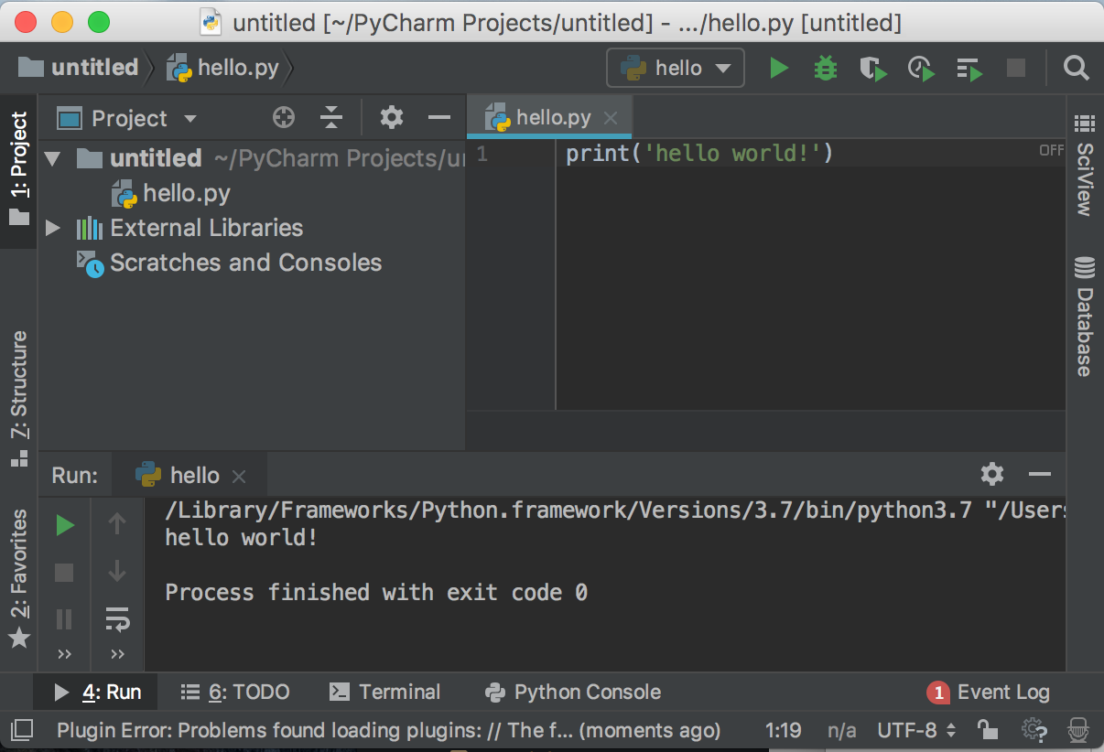
Last time
Hello World!

Slide 4
This week
Variables - storing data in your program
String, integer and floating-point data types
Basic math with numerical data*
Comments
Joining and repeating strings
print() - displaying data
input() - getting data from the users
len() - how many letters in some text?
* Adding, subtracting, multiplying, dividing. Nothing scary!

Slide 5
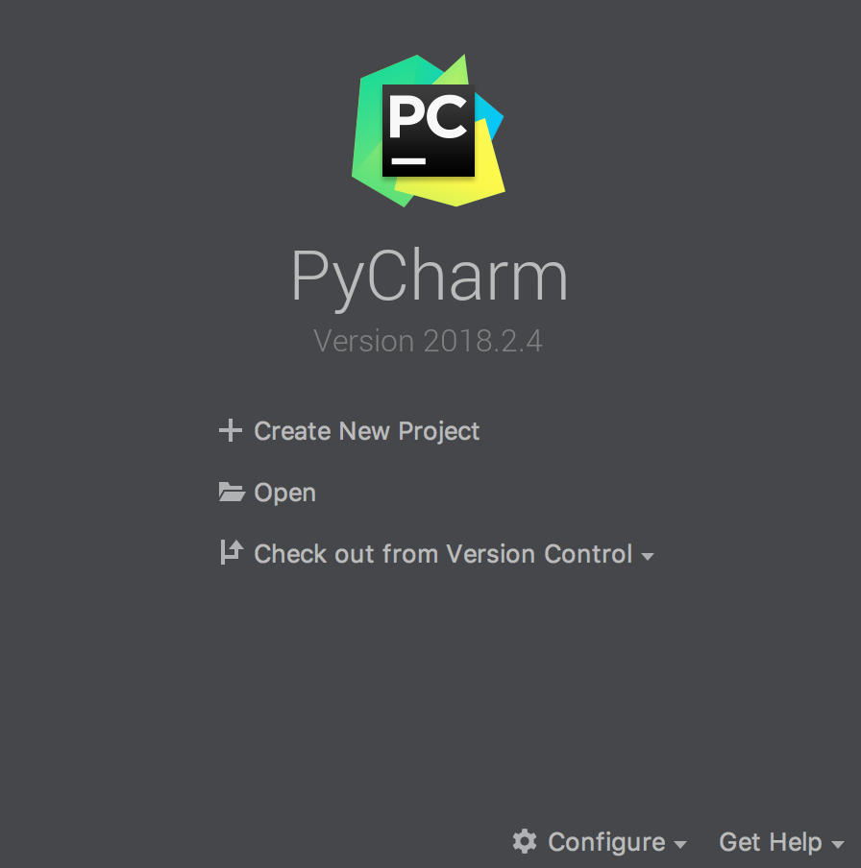
Open PyCharm
Click Create New Project

Slide 6
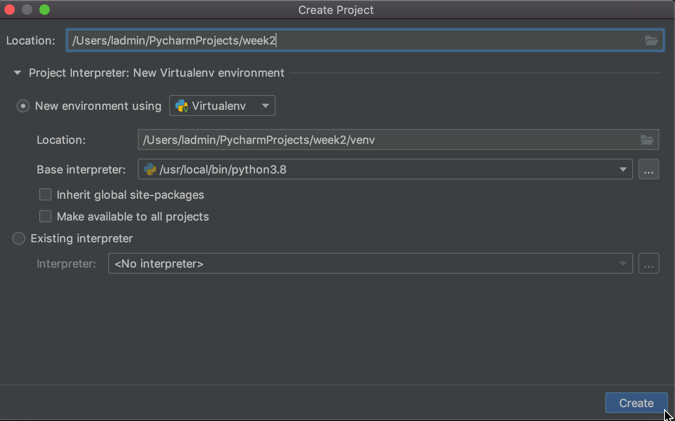
Project settings
Change "untitled" to week1
Optional - change the location to another directory/folder if you like
Change the suggested name untitled to week2
Set or verify the Project interpreter, make sure no errors

Slide 7
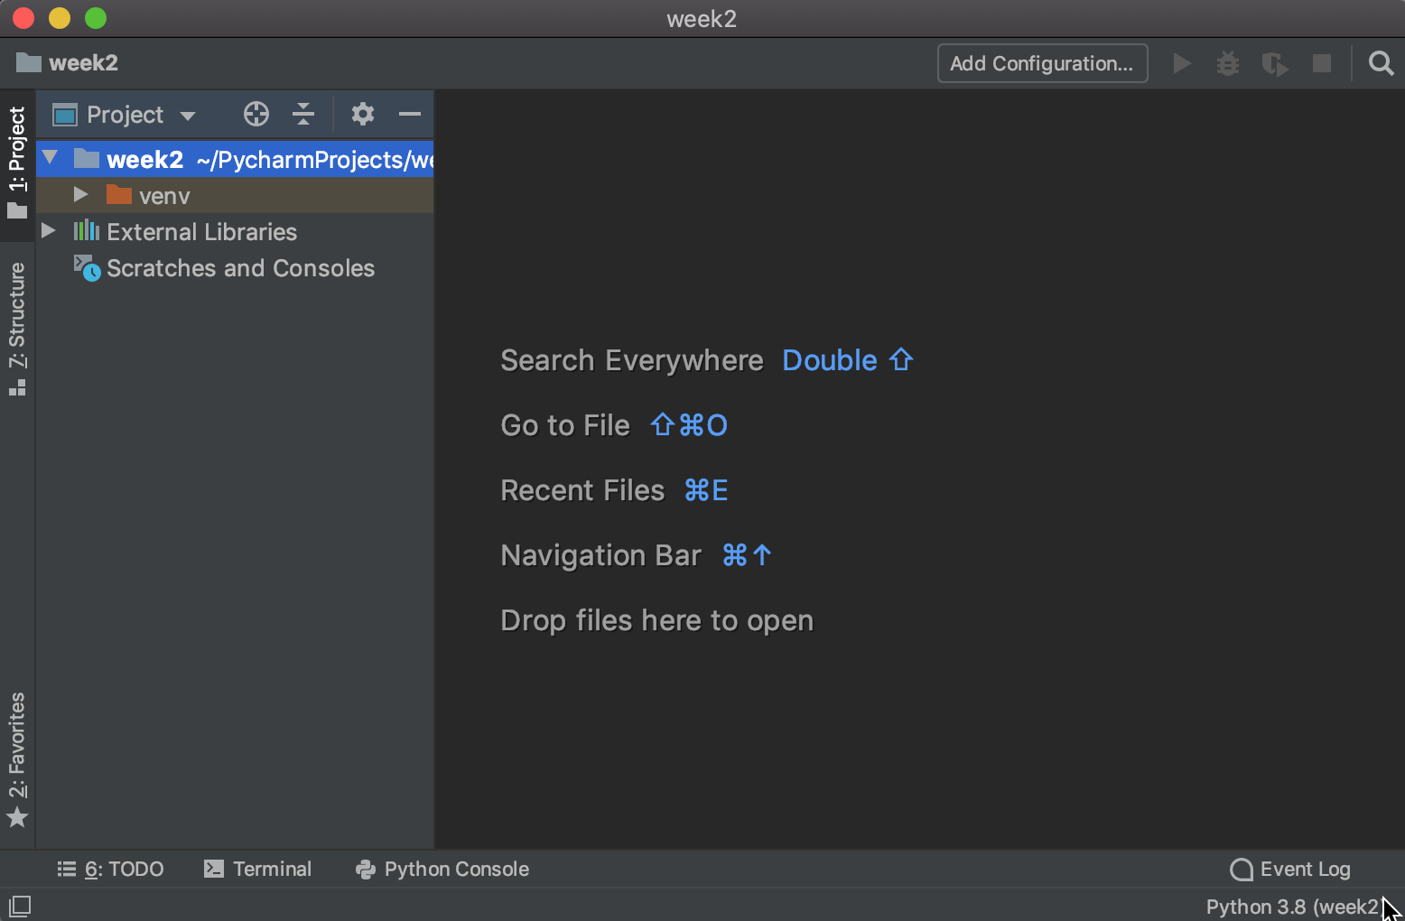
New Project
A PyCharm project is for managing one or more Python files, and any associated files that are needed for running the program
This screen has the file manager on the left
The area on the right is for editing files when they've been created
Let's create a new Python file
Project file manager
File editor

Slide 8
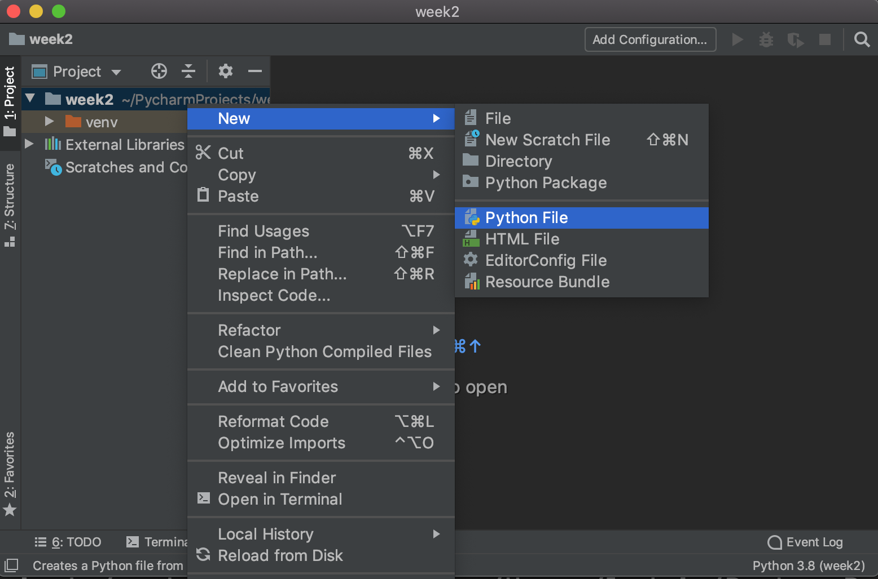
Create a Python file in the new project
Look on the left side of the screen, for your project name, week2
Right-click on your project name
Select New and then select Python File
Remember we will ignore
the venv directory
Right-click on your project name

Slide 9
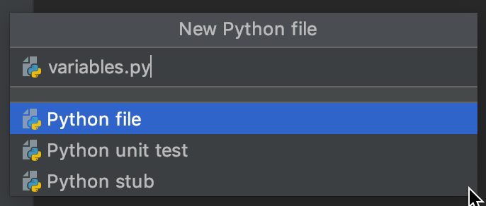
Call your file variables.py
Type variables.py in the Name box
Verify the Python file is highlighted in blue
Press Enter to create

Slide 10
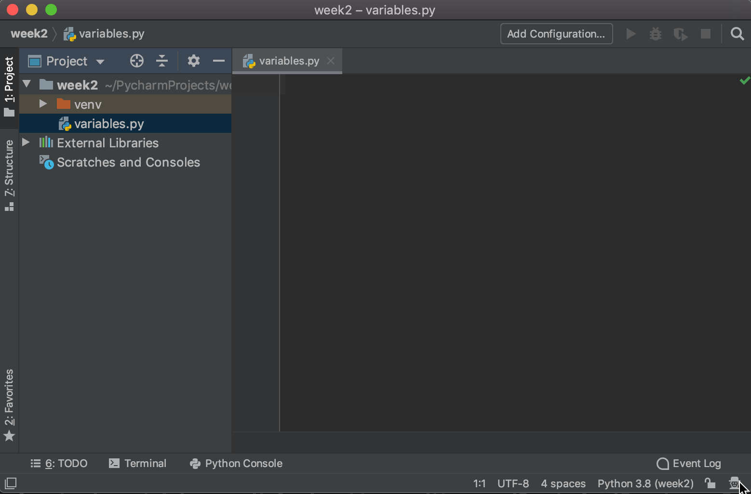
New variables.py file
The new file should open for editing
If not, click on your project name to expand the list of files, and then click on the new file
Let's write some code in the editor
We'll write code here

Slide 11
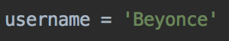
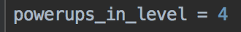
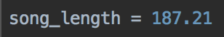
Variables
Programs store and work with data
A word processing program manages the data of your document
A video game manages data of where your player is, and where the other players and objects are
A media player tracks what song is playing, the bytes of that song, what to play next
A social media application may show a friend list; the text of a conversation

Slide 12
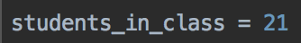
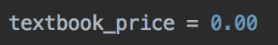
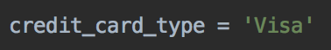
Python variables
variable name is students_in_class
data stored is 21
Data type is integer number
All variables need three things:
A name, used to refer to the variable
The data the variable stores
What type of data is it?
When you create a variable, you give it a name
And, you put some data it it
And then Python will figure out what type of data you put in the variable, and make a note of the type
variable name is textbook_price
data stored is 0.00
Data type is floating point number
variable name is credit_card_type_
data stored is 'Visa'
Data type is string (text)

Slide 13
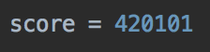
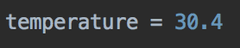
Data Types
Many different types, but three of the most common are
string, for storing text data
integer (whole) numbers
floating point (with decimal places) numbers

Slide 14
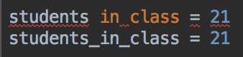
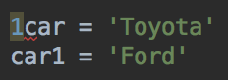
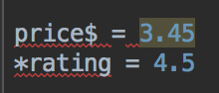
Rules for variable names
Why is
students in class
not a valid name?
Variable names have rules - they must be all one word
Variable names are made of letters
Can't start with a number, but can contain numbers
Can't use most symbols, except underscore _
Why isn't 1car a valid name?
Is car1 a valid name?
What's wrong with these names?

Slide 15
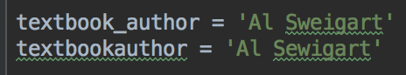
Rules for variable names
Symbols are not allowed, except underscore _
Using _ in names helps readability if your variable name is more than one word
Descriptive variable names are a good idea, to help understand a program
You can use uppercase letters, but Python programmers usually prefer lowercase for variable names. Later we'll see some examples where uppercase letters are used in names. This is a valid variable name, but recommend sticking to all lowercase.

Slide 16
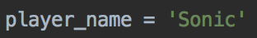
String (text) data
Text data is called string data in programming
String data in your program must be quoted
So Python can tell what's a variable name, and what's the text to store in the variable
You can use single quotes or double quotes, but don't mix single and double quotes. Single quotes are much more common
You can put almost any characters in a String

Slide 17
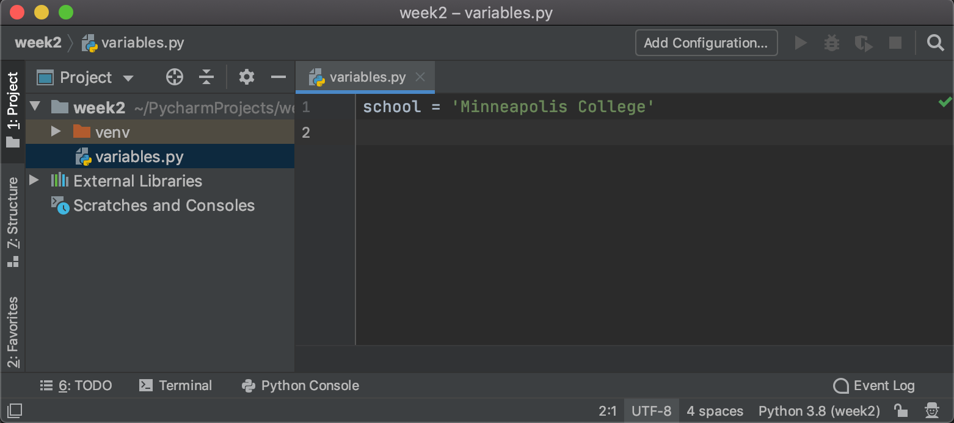
Your turn
In PyCharm, in the variables.py file you created, type the following
school = 'Minneapolis College'
You are telling Python to create a variable called school
And, to store the string data 'Minneapolis College'
But, nothing else happens in the program!

Slide 18
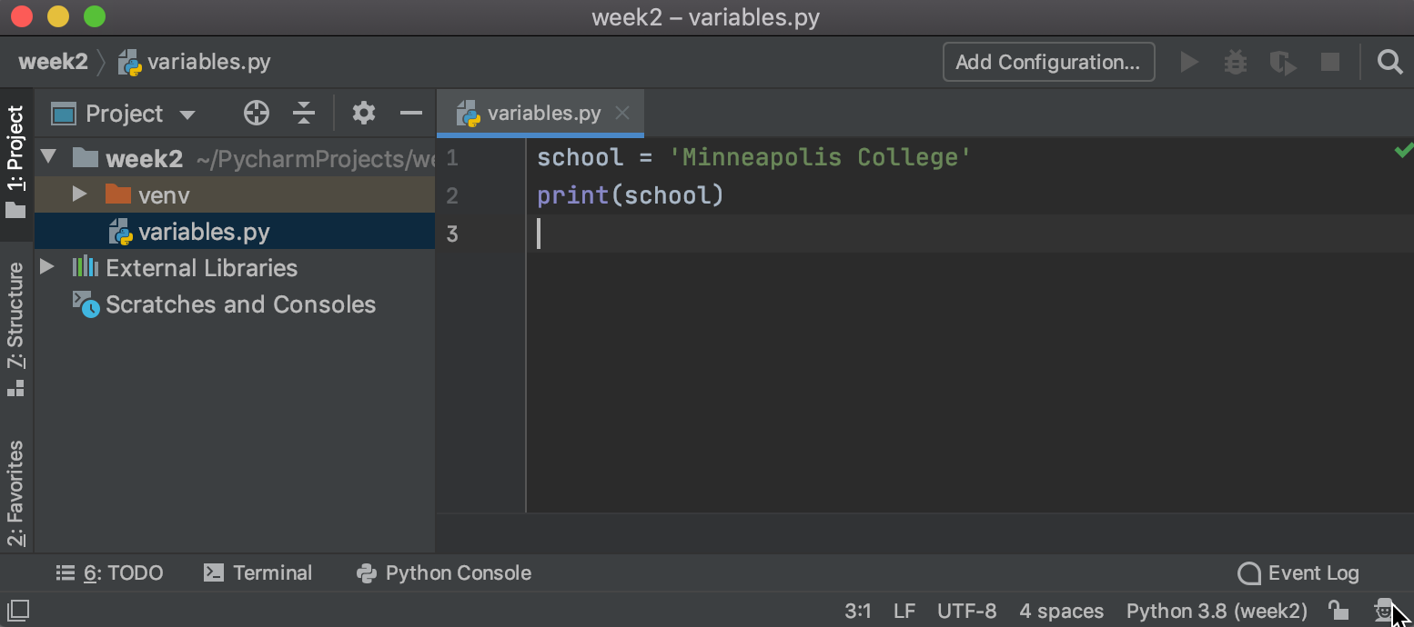
Let's do something with the data
Modify your program to this
school = 'Minneapolis College' print(school)

Slide 19
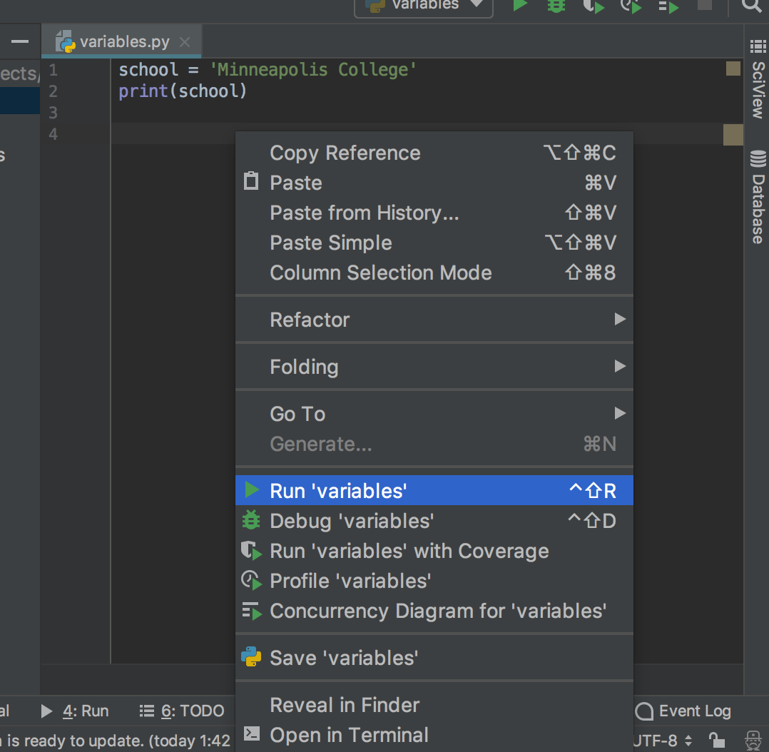
Run your program
Right-click in the editor, and select Run 'variables'

Slide 20
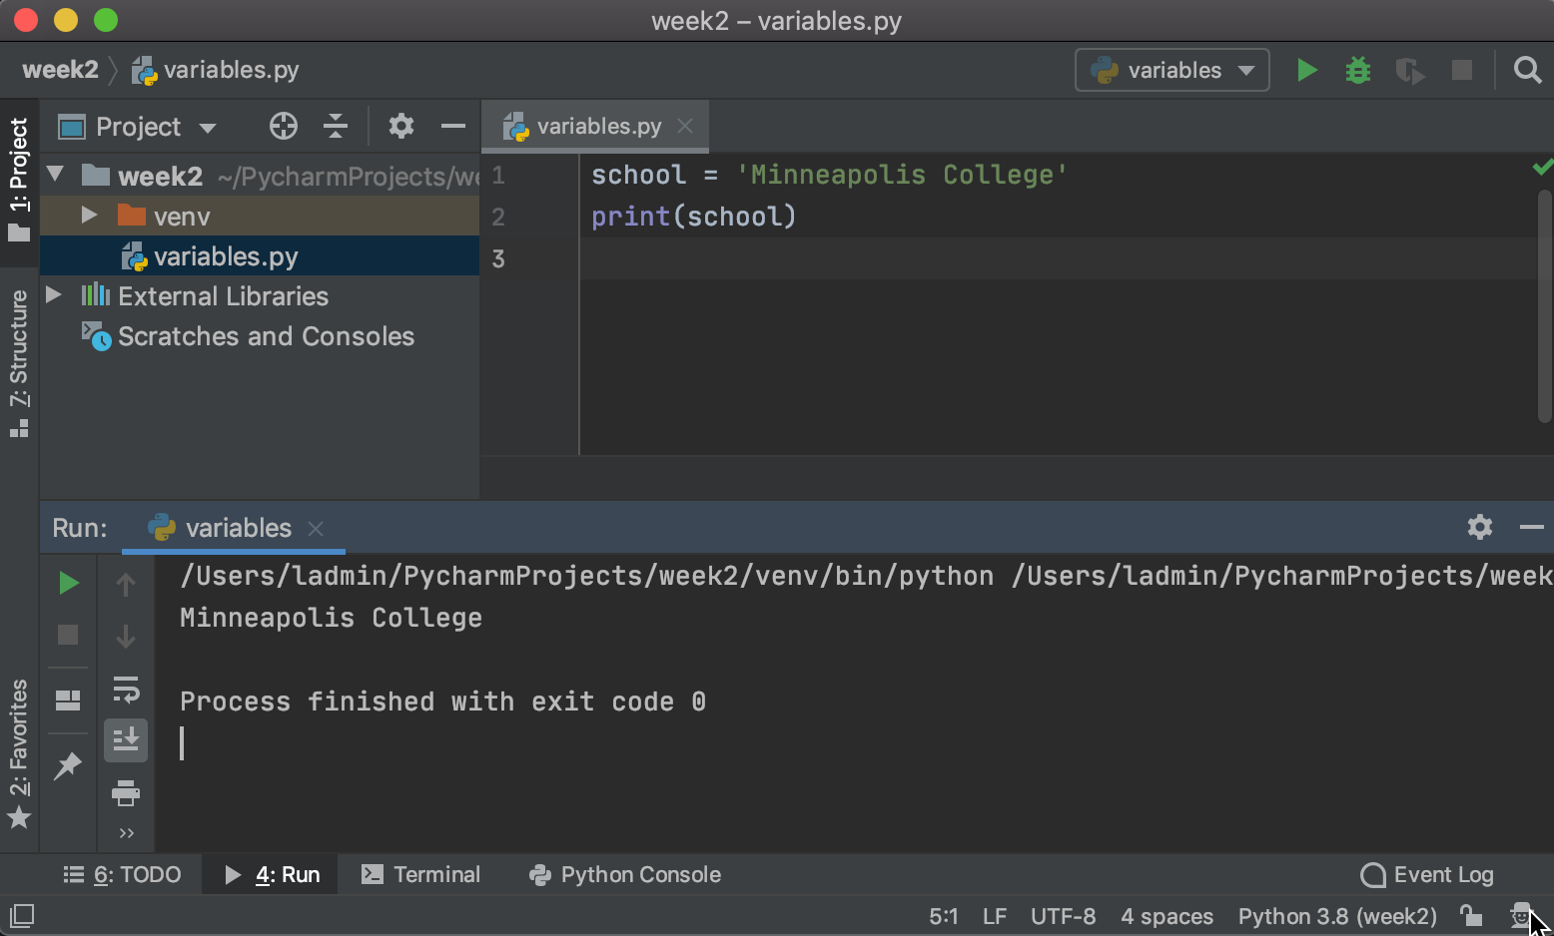
Run your program
Expected output
Program should print (display) Minneapolis College
Errors? Prints something else?
Check your code
Ask for help if you can't figure it out

Slide 21
When you run a program
The Python interpreter starts to read your program file, line by line
For each line:
It reads the line
It tries to figure out what the line means
Then, carries out the instruction from that line
Repeat for each line in the program, until the end of the file

Slide 22
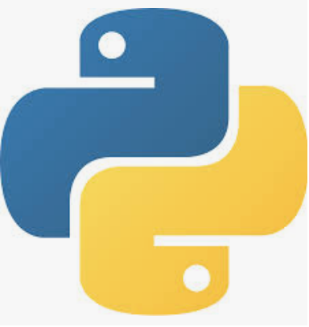
When you run a program
The Python interpreter starts to read your program file, line by line
For each line:
It reads the line
It tries to figure out what the line means
Then, carries out the instruction from that line
Repeat for each line in the program, until the end of the file
I'm the Python interpreter. I run your code

Slide 23
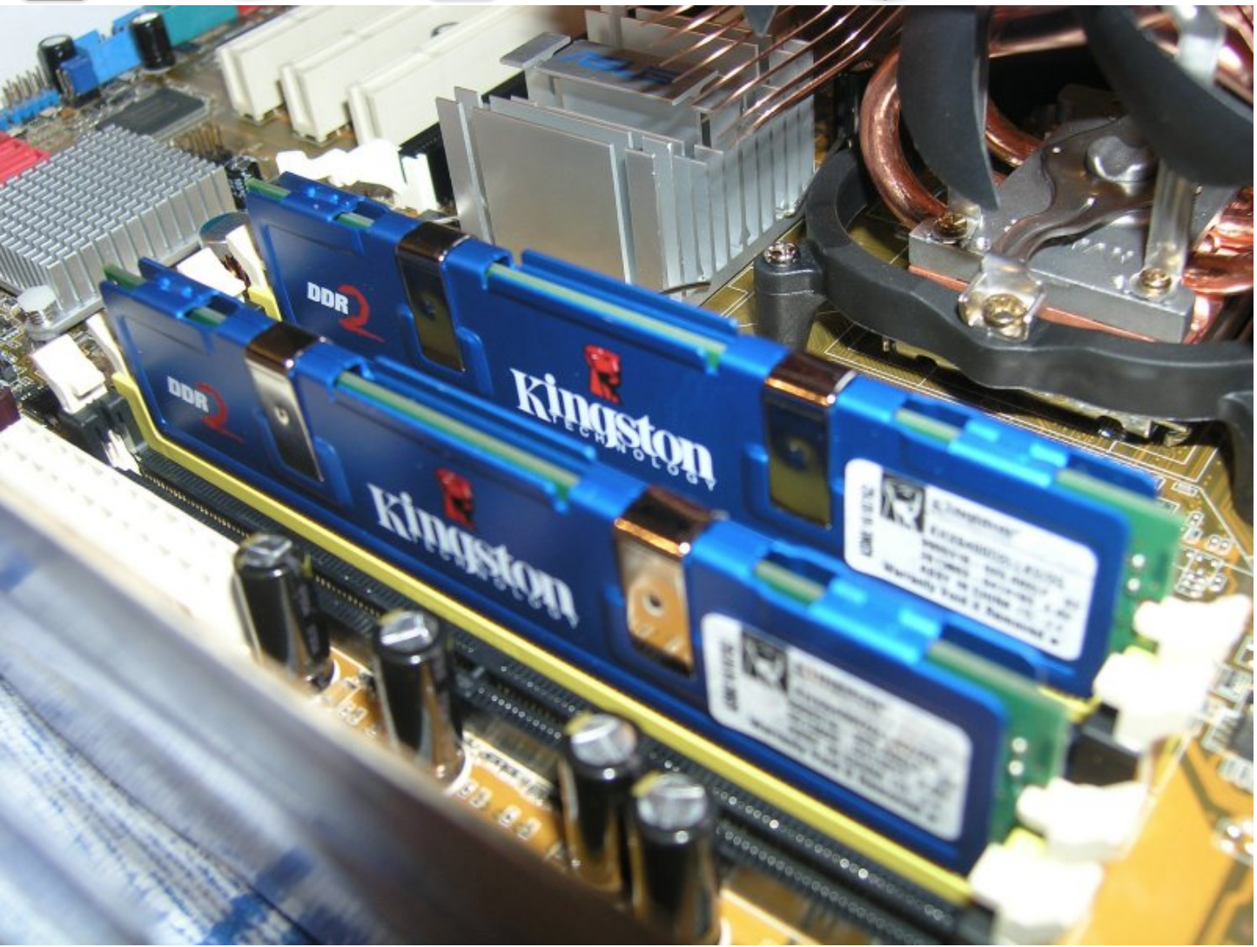
The first line is
school = 'Minneapolis College'
I need to create a string variable called school, and store 'Minneapolis College' in it
school (string) = 'Minneapolis College'
OK!
Hey, memory! Make a variable called school that can store strings. Put 'Minneapolis College' in it
Memory

Slide 24
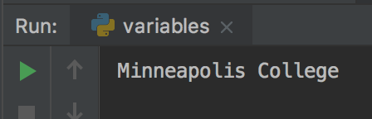
The next line is
print(school)
school (string) = 'Minneapolis College'
I need to check the memory for a variable called school, get the data stored in it, and print it
Yes!
school = "Minneapolis College"
Hey, memory! Have you got a variable called school? What's in it?
Memory
Hey, console! Display these characters:
Minneapolis College
ok!

Slide 25
The next line is...
There's no more lines
My job is done. Bye!
Python is done, I'll delete all of the data I stored for the program
Memory

Slide 26
Variables
Variables are created as the program runs
When the program ends, all data in the variables disappears
The data stored in memory is deleted when the Python program stops running your program
So when your program ends, all the data is gone
There are ways of storing data permanently, we'll look at some methods later in the semester

Slide 27
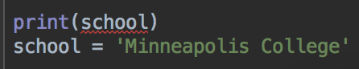
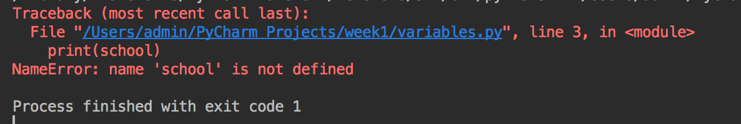
Running a program
Remember that Python reads one line at a time
And follows the instructions in order
What happens if the lines are swapped? Try it out, run your program
Put them back in order and make sure your program runs again
See the red underline under school in the first line? PyCharm has recognized the problem
Running the program - error!
Why?

Slide 28
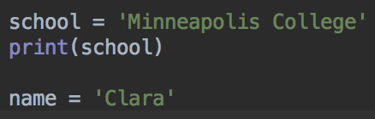
Create another string variable
Can you create another variable called name that stores your name?
For me, I'd write
name = 'Clara'
Remember the quotes around the data
What's the variable's name?
What type of data does it store?
What data is stored in it?

Slide 29
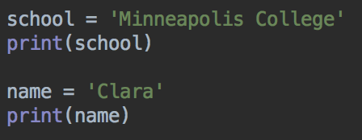
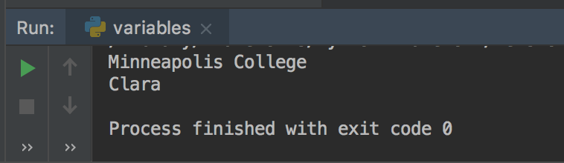
Print the data in the name variable
print(name)
Run your program, make sure it prints both variables
print() is a function - it runs some other code that makes the text display in the console

Slide 30
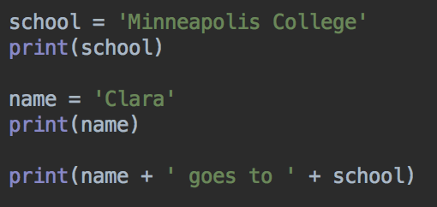
Tidy the output
We can print more than one thing at once
Add this line to the end of your program
print(name + ' goes to ' + school)
What do you think it will print?
Run your program to check
Watch where the quotes go

Slide 31
Variable names don't need quotes
String data does need quotes
Strings and string variables can be joined together using +
Variable
String data, needs quotes
+ joins
strings together
Variable

Slide 32
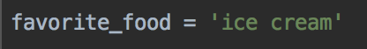
Your turn - keep working on the same program
Create another new variable called favorite_food
Store a string describing your favorite food in this variable
So for me, I'm going to write
favorite_food = 'ice cream'
but you might prefer broccoli, so you might write
favorite_food = 'broccoli'
Replace with your favorite food

Slide 33
Print your favorite food
Can you print your favorite food?
Using your three variables name, school and favorite_food, can you print a line that says something like
My name is Clara, I go to Minneapolis College, and my favorite food is ice cream
Use the + symbol to join the variables and strings together
+ joins, or concatenates strings

Slide 34
Print all the information about you
Code, concatenating strings
Output

Slide 35
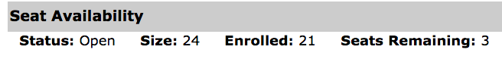
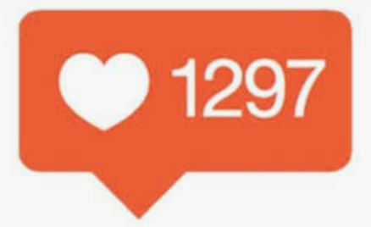
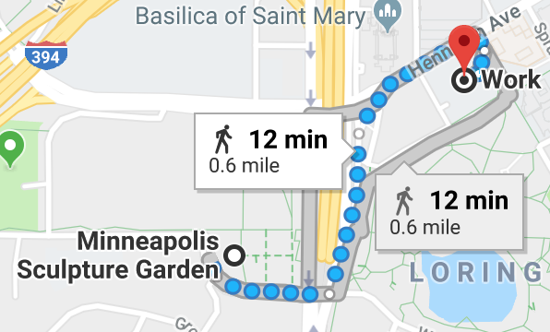

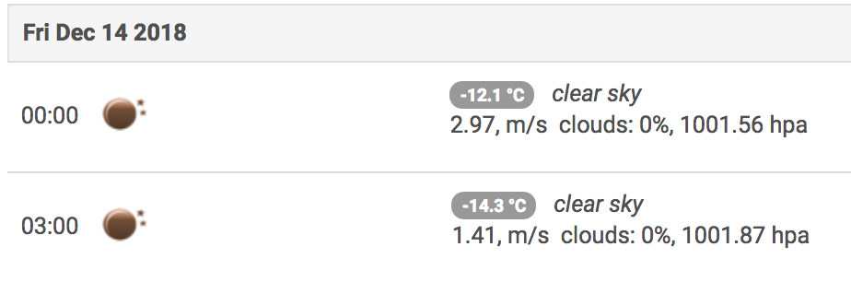
Number data - int and float
int
for storing integer numbers, any whole/round numbers
examples: 0, 4, 42, 100, -10, 100000000000000
Use ints to store number of students, lives in a video game, number of likes for a social media post, number of times a user can get a password wrong before they are locked out...
float
for storing floating-point numbers, these are numbers with decimal places
examples: 4.5, 3.14159, -100.00000001, 42.0
(So any int is a float too)
Use floats to store prices, temperatures,
distances, sales tax rates, quiz scores, GPA, video game health...

Slide 36
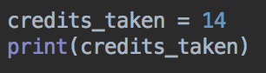
Creating an int variable
How many credits are you taking this semester?
Create a variable in your program to store this number
For example, you can add this to your program
credits_taken = 14
Can you print the number of credits?
Run your program to check

Slide 37
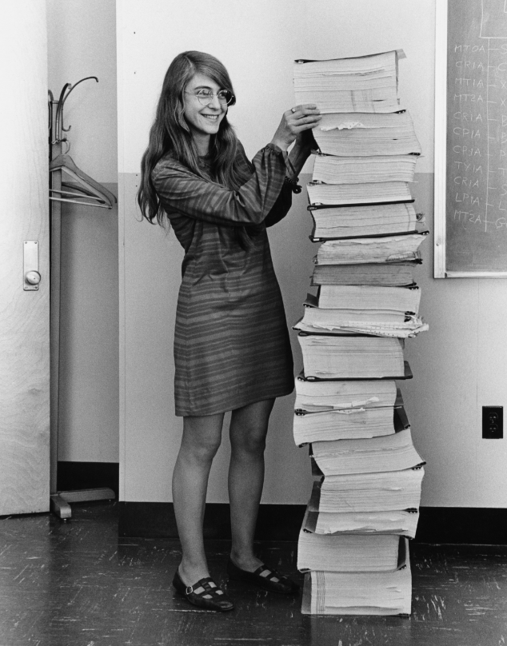
Creating an int variable - math
Early computer programs were intended to do math
Computers were faster and more accurate than humans, and they never get bored or tired
Example: NASA using computers to figure out launch trajectories for rockets or control command modules
Margaret Hamilton, NASA software engineer, and a printout of code written for the Apollo space project.

Slide 38
Creating int variables
554 trained astronauts have been to space as of June 2018
And, 7 space tourists have been to space
So, how many people in total have been to space?
Create some variables, and Python can do the math
We'll store the data in variables, and the total in another variable
https://en.wikipedia.org/wiki/List_of_space_travelers_by_name, https://en.wikipedia.org/wiki/Space_tourism

Slide 39
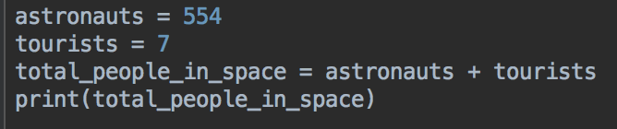
Code
Write this code, run and test
Create two variables, astronauts and tourists to store data
Create a third variable, total_people_in_space
The data in total_people_in_space is made from adding the data in the astronauts and tourists variables

Slide 40
Code
This tells Python to get the data in astronauts variable, and get the data in the tourists variable, add it together, and save the result in a new variable called total_people_in_space

Slide 41
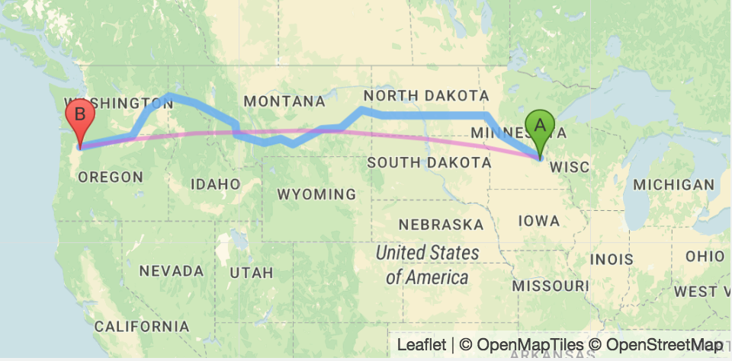
float variables
Minneapolis College is 1425.81 miles from Portland Community college in Oregon
Minneapolis College is 907.29 miles from Helena College in Montana
In your program, create two variables miles_to_portland and miles_to_helena to store these numbers
How far is it from Helena to Portland?
Let's get Python to do the math
Data from https://www.distance-cities.com

Slide 42
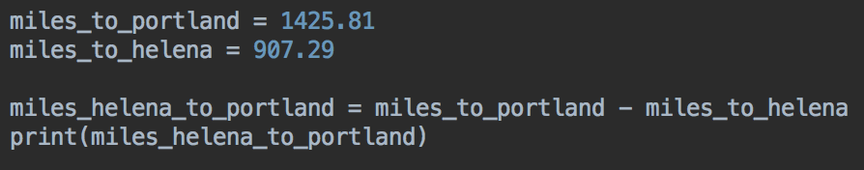
Miles from Helena to Portland
Run and test your code
The answer should be 518.52

Slide 43
Another number example
Popcorn costs 4.25 at the movie theater
You go to the movies with your friends, and buy three bags of popcorn
How much did that cost?
Let's figure it out with Python
What variables do we need?

Slide 44
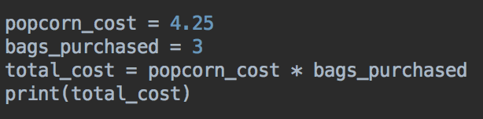
Popcorn
This uses a float and an int variable
Multiplication is done with the * symbol
Run your program - the output should be 12.75
Question: what type of variable is total_cost? float, int, string?
* means multiply

Slide 45
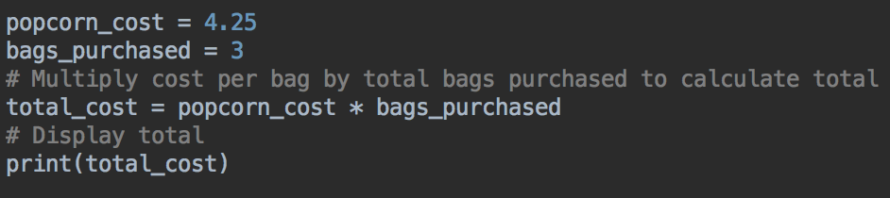
Comments
Programs can be hard to understand
It's often useful to add comments or notes to your program to help explain what's happening
If Python sees a # (hashtag, pound) it will ignore everything after it on that line
So, you can write notes to yourself and Python will ignore them
comments

Slide 46
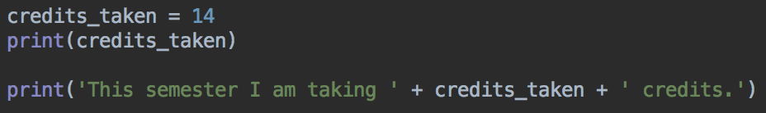
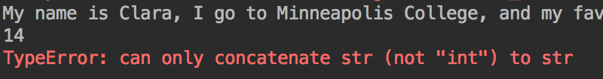
Joining strings and numbers
What if you want to print 'This semester I am taking 14 credits'
We know that we can join string data and string variables with +
Let's try that with numbers
But when we run the program, there's an error

Slide 47
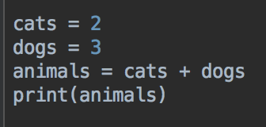
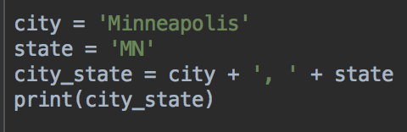
+ operator
If you add two numbers, Python assumes you want to do math, not concatenate the data
The animals variable is 5, not 23
If you add two strings, Python assumes you want to concatenate the text, not try to do math
Again, it does the right thing
city_state is 'Minneapolis, MN'

Slide 48
+ operator
But what if you add a number and a string?
Do you want to do math, or concatenate?
You can't do math with strings and it's unlikely to want to concatenate two numbers
So Python assumes you've made a mistake, shows you an error message and the program ends
Programming languages like you to be very clear about what you mean
What if you wanted to do math, but accidentally used a string variable instead of an int?
Ambiguity is bad in programming - it leads to bugs and errors
You need to be very specific in what you want Python to do

Slide 49
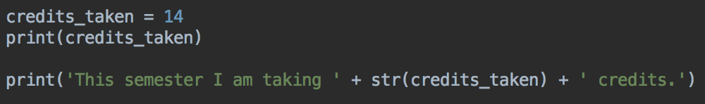
Joining strings and numbers
So, if you want to concatenate string and ints and floats, need have to convert the number to a string, and then we can join them together
Use the str() function. Put the number variable inside the parenthesis
Watch where the parenthesis are - your int / float variable is inside
The rest of the code doesn't change

Slide 50
Joining strings and numbers
Can you do the same with your miles between Helena and Portland?
Change your program so it uses the miles_helena_to_portland variable to print
"It is 518.52 miles from Helena to Portland"

Slide 51


Joining Strings and Numbers
Example solution
Output

Slide 52


input()
You often want to get data from the program's user
input() function can ask for data that can be used in your program
Try this code, and run your program
In the console, your program will pause and wait for you to type
Type your name and press return
Your program should print a greeting message like this

Slide 53
input numbers
The input() function is used to get strings
What if you need a number, like today's temperature, or the number of students in the class, or the distance to Seattle?
Could try this...
This works, but whatever the user types will be saved as a string
Its's 1391.25 miles to Seattle from Minneapolis. If the user types in that number, Python will create a string variable miles_to_seattle and save the string '1391.25' in it
You won't be able to do math or other numerical operations with a string variable

Slide 54


fix - int() or float()
Similar to converting numbers to strings for output.
Have to convert strings to numbers.
Now we can do math, for example, convert to kilometers
To convert miles to kilometers, multiply by 1.609

Slide 55
Putting it all together
Invoice Program
Ask for the name of a product sold
Ask how many were sold
Ask for the price of one item
Do the math to figure out the total price
Print a neat invoice with all the data in
Comment code

Slide 56


In your project, create a new Python file
Right-click on the project name, new > Python file
Call it invoice.py

Slide 57

Code – type this, run and test, make up some numbers and check the answer seems correct

Slide 58

Example output
Make up some data for your program

Slide 59
Optional: len()
Calculates how many characters are in a string
For example, how long is your name?
Real world applications:
Useful for figuring out if a password is long enough
Validation: is a credit card number exactly 16 digits long?

Slide 60


Optional: len()
How many letters in 'Minneapolis College' ?
Or we can combine the functions!

Slide 61


Optional: How long is your name?
Add the last two lines to your program
Check it works for you too

Slide 62
Error messages
You are going to see a lot of error messages!
Don't worry, all programmers do. It's almost impossible to write perfect code the first time
It's not a bad thing. It's telling you what Python doesn't understand, so you can fix it
Review your code carefully, and ask for help if you can't figure out what's wrong

Slide 63

Reading: Chapter 1
The book uses Mu and the Python Shell
When you see Mu, think PyCharm
When you see Python Shell, open the Python Console in PyCharm

Slide 64
Discussion Question
How would you describe what a variable is?

Slide 65
Lab/Homework 1
Instructions are in D2L
Any questions? Need help? Please ask, email, come to open lab

